Slide 1
Rockbuster Stealth LLC
Data Analysis Project
Claudia Lan Yee Chiu

Slide 2
TABLE OF CONTENTS
01
02
03
04
Rockbuster Facts
Geographical Data
Analysed Data Overview
Rockbusters Revenues Geographical Location
Customers Data
Recommendations
Most Valuable Customers Location
Where to go from here?

Slide 3
Project Overview
Rockbuster Stealth LLC is a movie rental company that used to have stores worldwide.
Facing stiff competition from streaming services such as Netflix and Amazon Prime, the Rockbuster Stealth management team is planning to use its existing movie license to launch an online video rental service in order to stay competitive.

Slide 4
Data Analyst Role
Hired by the Rockbuster Stealth´s business intelligence department
Load all provided data into a relational database management system
Use SQL to analyze the data
Answer any ad-hoc business questions from other departments
Guide the company´s strategy for the new online video rental service
Expected to provide data-driven answers to a series of business questions to be used for the 2020 company strategy.

Slide 5

Key Questions & Objectives
Rating Revenue
Rental Duration
Which movies contributed the most/least to revenue gain?
What was the average rental duration for all videos?
Customer
Location
Analysis
Geographical
Location
Which countries are Rockbuster customers based?
Where are customers
with a high lifetime
value based?
Do sales figures vary between geographical regions?

Slide 6

01
Rockbuster Facts
Let´s dive into some figures…

Slide 7
Rockbuster Data Overview
599
1000
Sports
Total # of Customers
Total # of Movies
Most Popular Genre followed by Animation, and Action
5 days
PG-13
India
Average Rental Duration
Most Popular Rating
Country with largest Customer Count

Slide 8
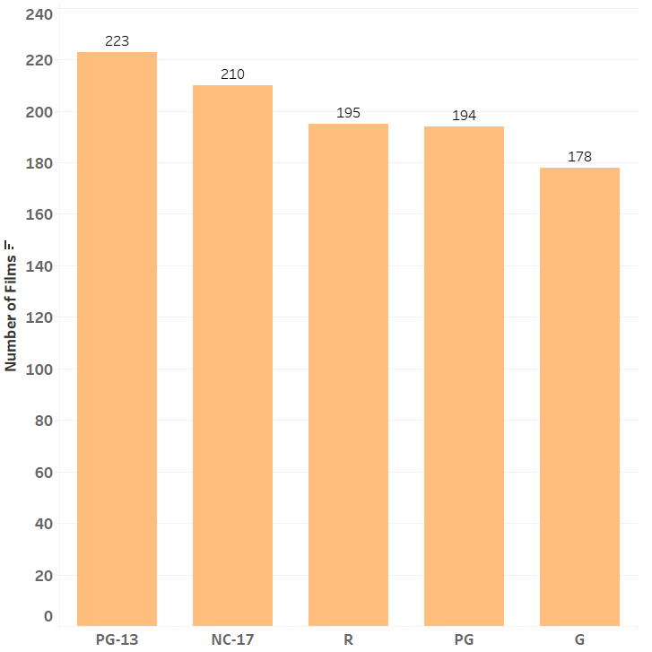
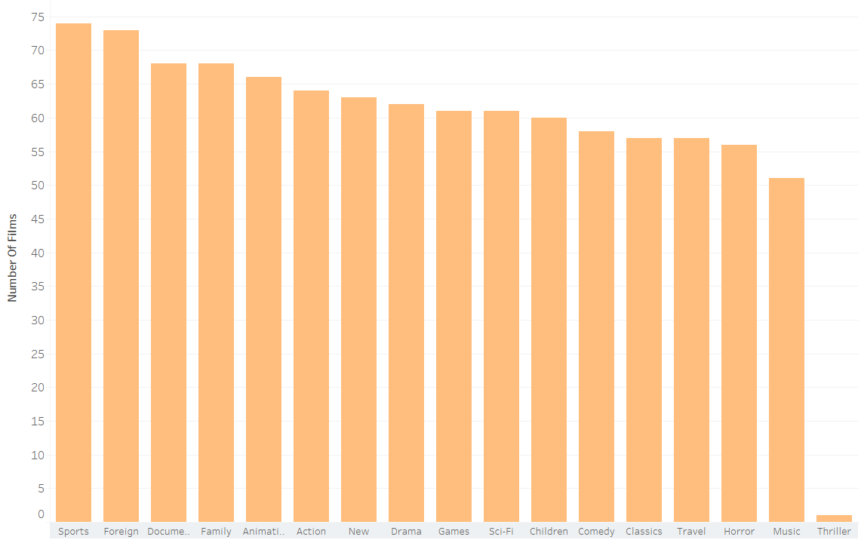
Film Count per MPAA Rating
Film Count per Genre
MERCURY
Mercury is the closest planet to the Sun
VENUS
Venus is the second planet from the Sun

Slide 9
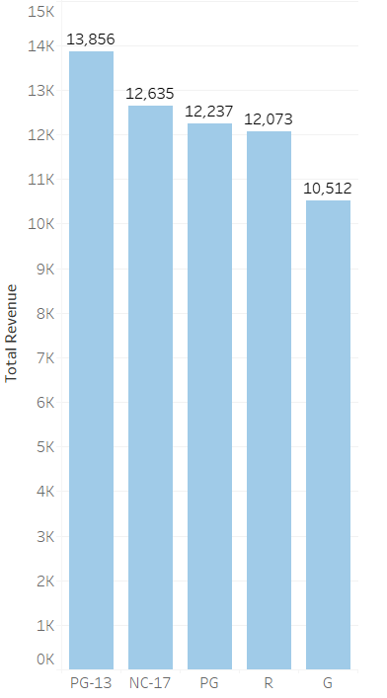
Film Revenue by MPAA Rating
PG-13
Grossed the highest revenue
G
Earned the least amount
NC-17 PG R
Provided almost equal amount in revenue

Slide 10
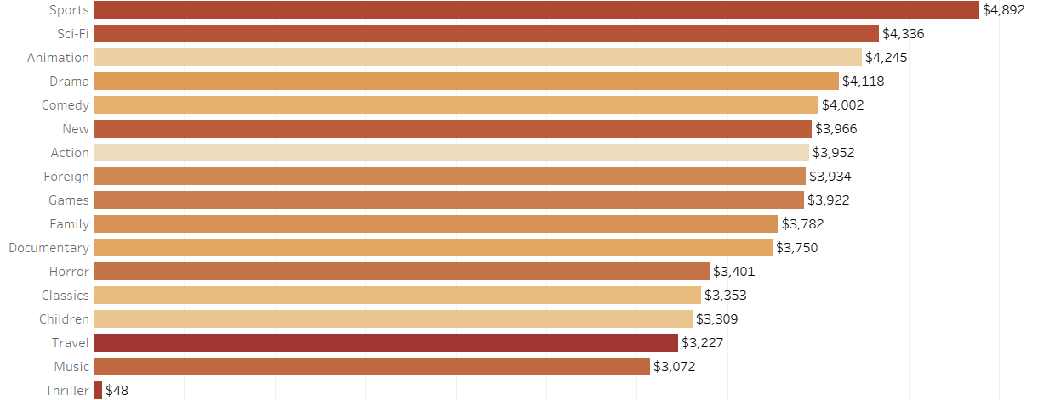
Global Revenue by Movie Genre
Sports, Sci-Fi, Animation lead in terms of Revenue
Thriller Movies Revenue is exceedingly low

Slide 11
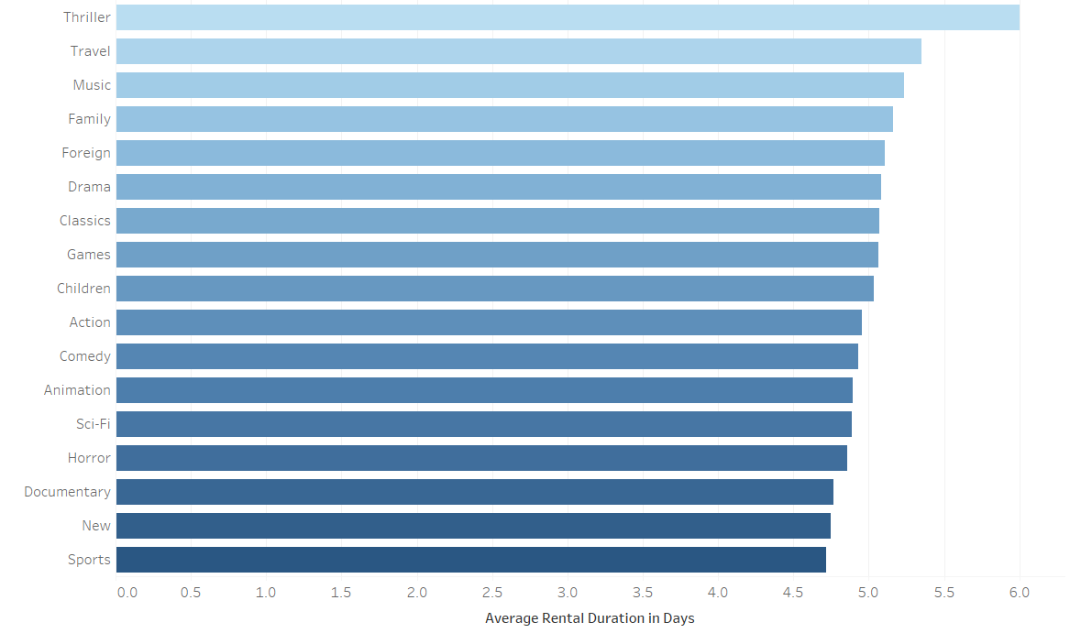
Average Rental Duration by Movie Genre
Sports, New, Documentary have the shortest average rental duration of 5 days
Whereas Thriller Movies are rented out for the longest period of time

Slide 12
Most Rented Movies
Telegraph Voyage
Zorro Ark
Top #1 Rented Movie
Total Revenue: $216,-
Category: Music
PG
Top #2 Rented Movie
Total Revenue: $200,-
Category: Comedy
NC-17

Slide 13
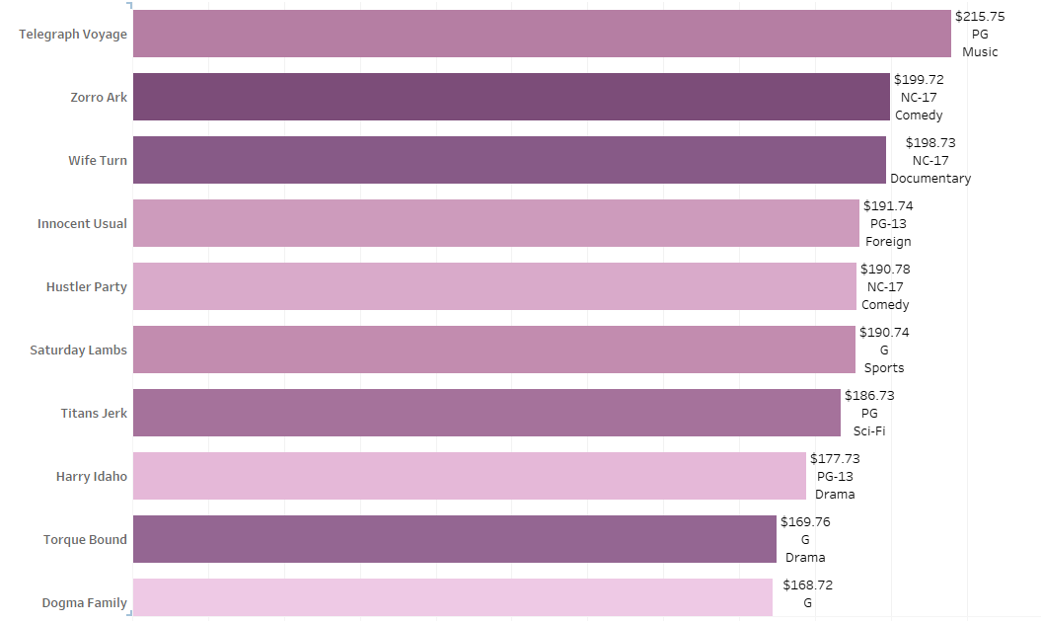
Top 10 Movies Rented from Rockbuster

Slide 14
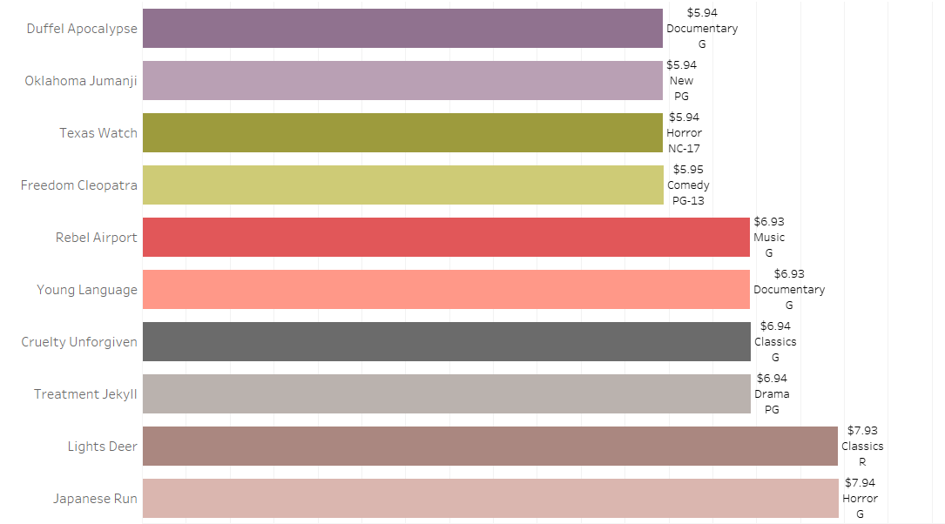
Least 10 Rented Movies from Rockbuster

Slide 15

0 2 Geographical Location of Rockbuster´s Revenues

Slide 16
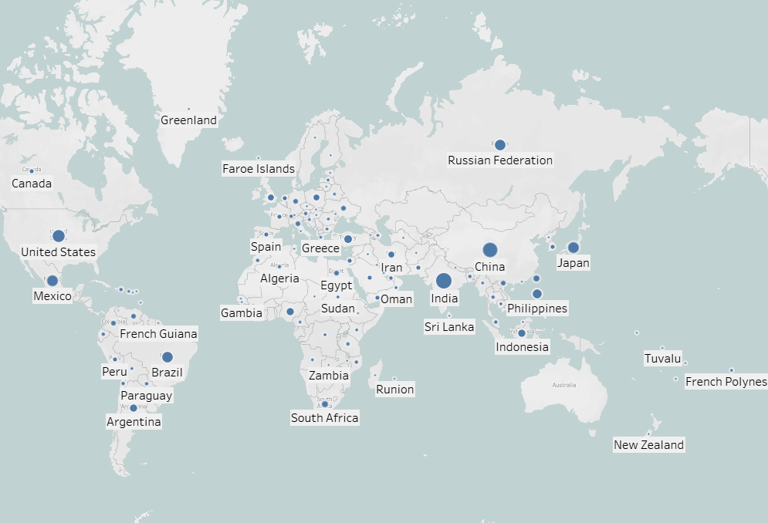
Customers Geographical Location
Rockbuster Customers are Located in
108 Countries Worldwide

Slide 17
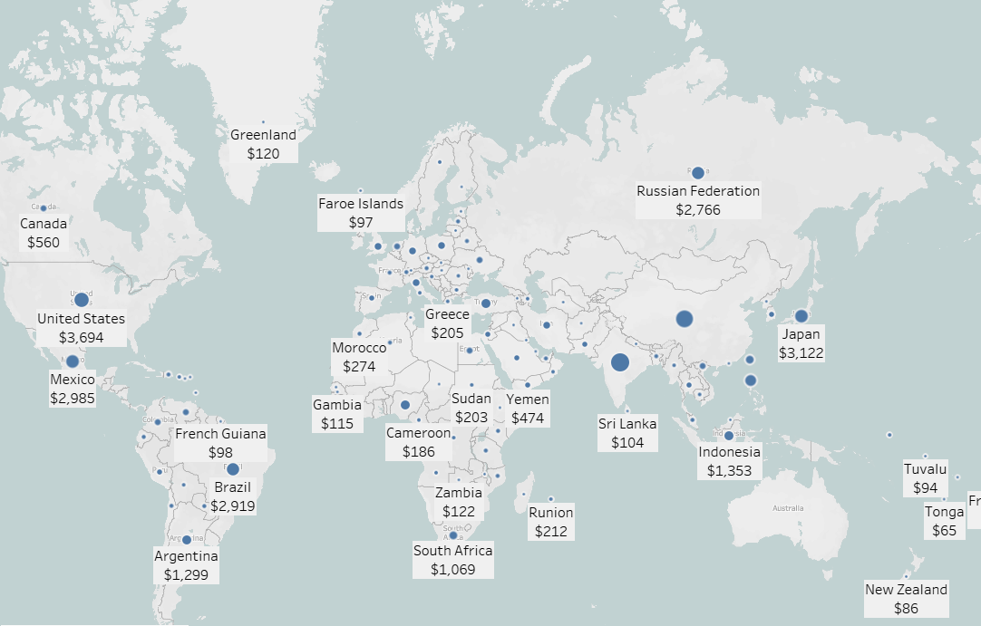
Top 10 Countries With Highest Revenue
Top 10 Countries:
India
China
United States
Japan
Mexico
Brazil
Russian Federation
Philippines
Turkey
Indonesia
India Boasts The Highest Revenue at $6,033

Slide 18
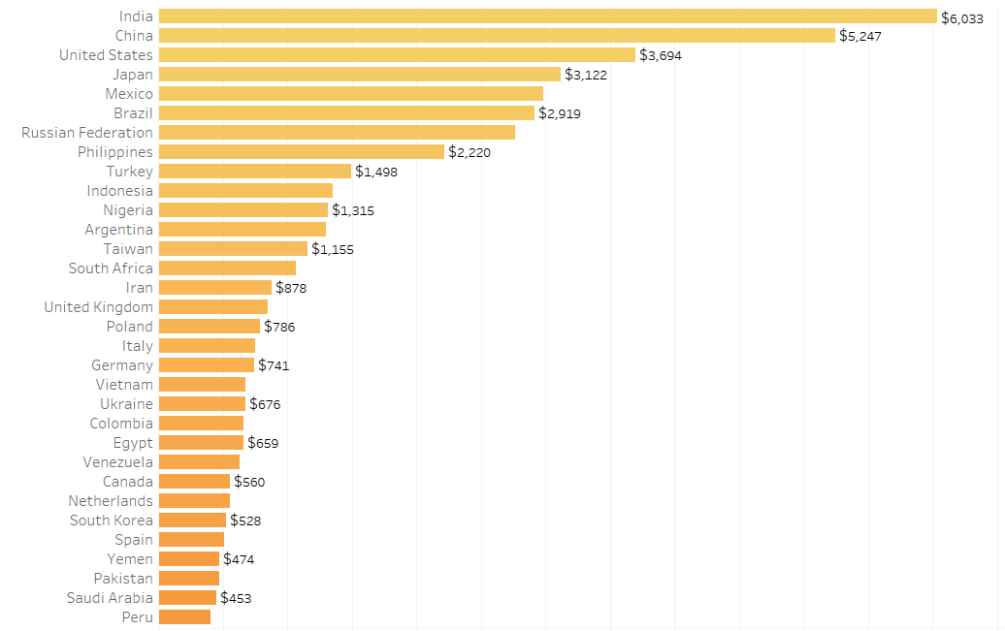
Main Countries Revenue

Slide 19

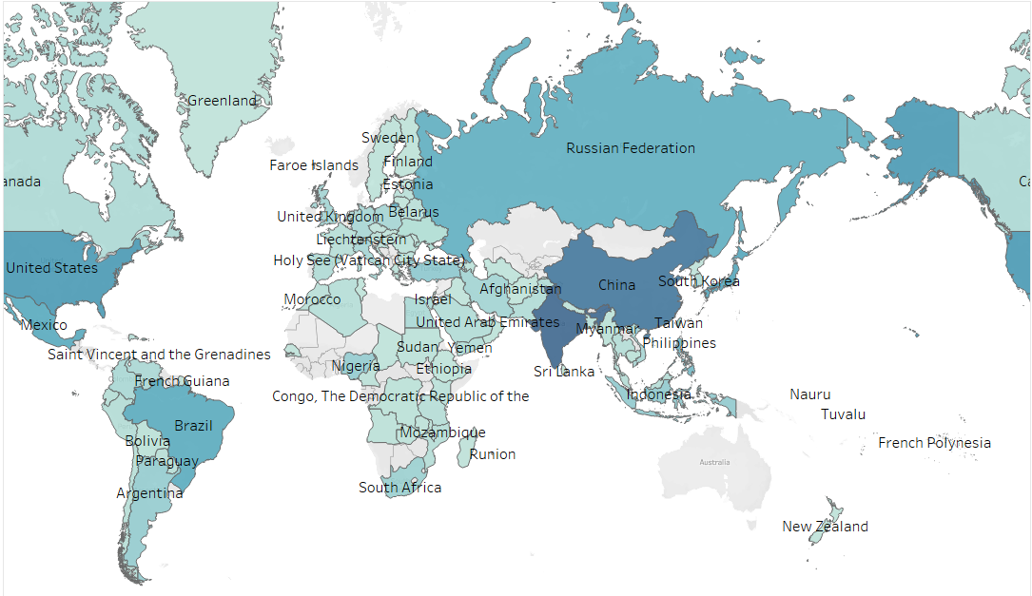
Rockbuster Customers Data
Where are the Customers located?
JUPITER
0
3
VENUS

Slide 20
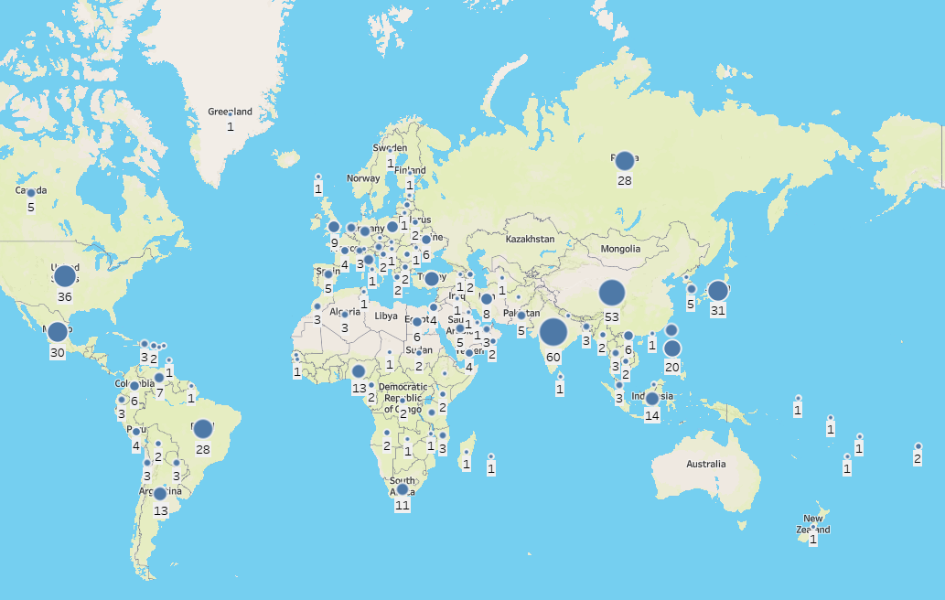
Customers Geographical Location
India has the largest count of 60 Customers

Slide 21
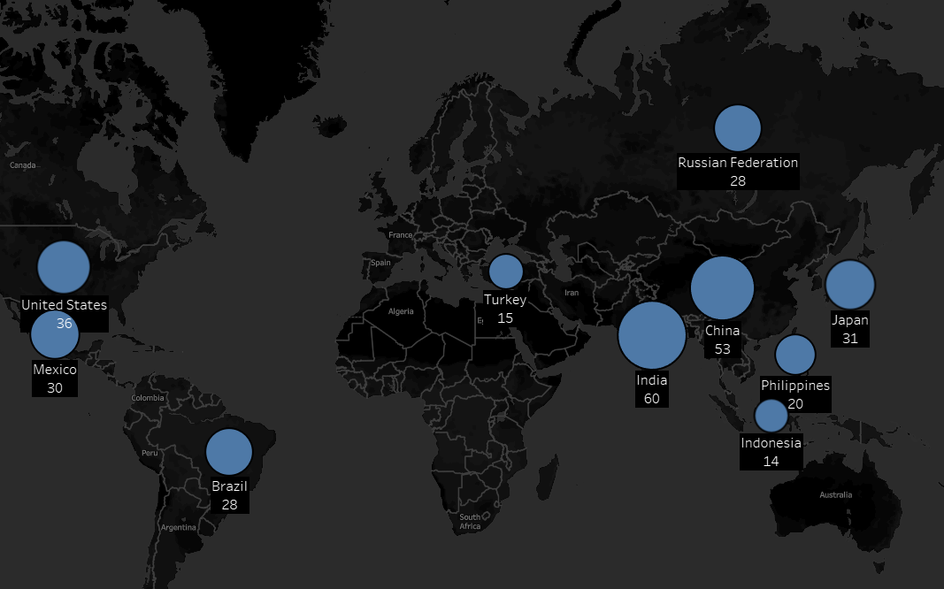
Customers from the Top 10 Countries
Top 10 Countries by Customer Count
India
China
United States
Japan
Mexico
Brazil
Russian Federation
Philippines
Turkey
Indonesia

Slide 22
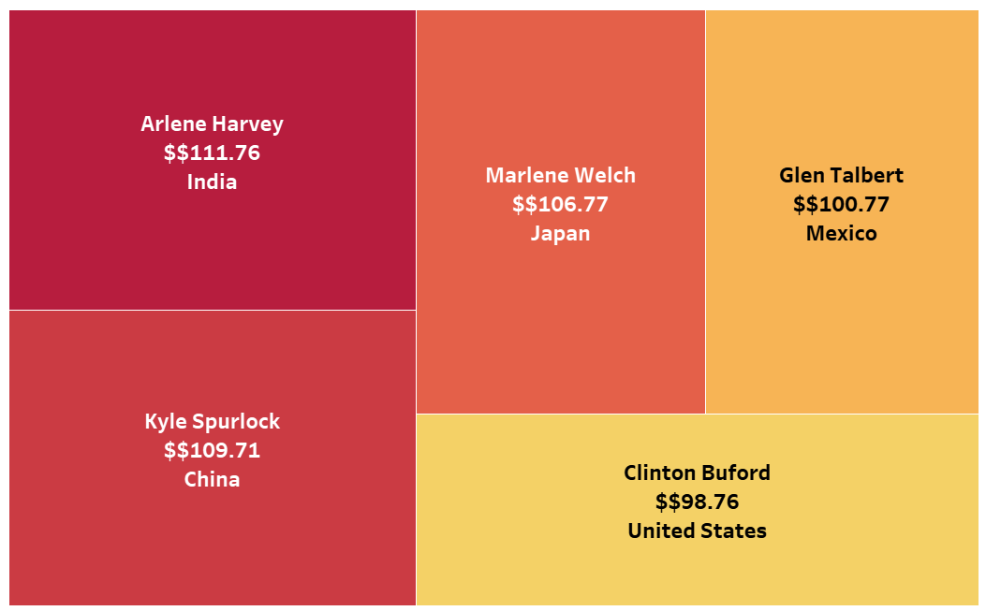
Top 5 Customers From Top 10 Cities
Top 5 Revenue-Generating Customers from the Top 10 Cities within the Countries with the highest Revenue

Slide 23
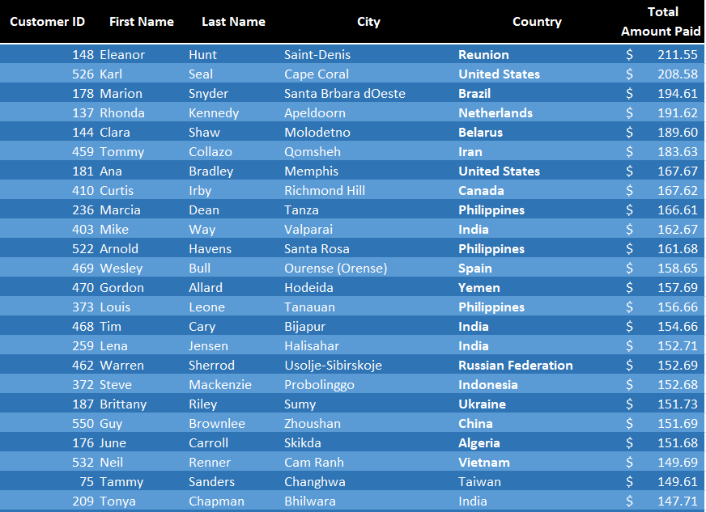
High Lifetime Value Customers Worldwide

Slide 24
RECOMMENDATIONS
0
4

Slide 25
ULTIMATE MOVIE EXPERIENCE
Launch Strategy
Marketing Strategy
Initiate the online streaming platform in the leading 5 countries initially. Subsequently, develop a strategy to extend its reach to the remaining top five countries.
Direct marketing efforts towards the online streaming platform in the five most populous countries/cities, which have the highest number of customers and revenue
Genre
Inventory upgrade
Concentrate on introducing the movie genres that generated the most substantial revenue within the top five countries
Expand the film inventory for high-earning categories Sports, Sci-Fi, Animation, Drama, and Comedy across the top 10 countries

Slide 26
Further Suggestions
Average Rental Duration
Reward
Reward the top 5 Customers to initiate the business growth
Promote shorter rental duration time to enhance marketing effectiveness and attract a wider audience
Flash Sales
Host time-limited flash sales where customers can rent movies at significantly discounted rates for a brief period, creating a sense of urgency and driving immediate engagement with the online movie rental service
Genre Movies
Add more movies to the most popular genres in Rockbuster´s 10 largest global market

Slide 27

THANK YOU!
All the Visualizations provided in the above slides can be further explored in the below Tableau dashboard:
https://public.tableau.com/app/profile/claudia.lan2171/viz/RockbusterStealthLLCDataVisualization_CLYC/RockbusterStealthAnalysis?publish=yes
Data Analysis: Claudia Lan Yee Chiu

